Slide 1
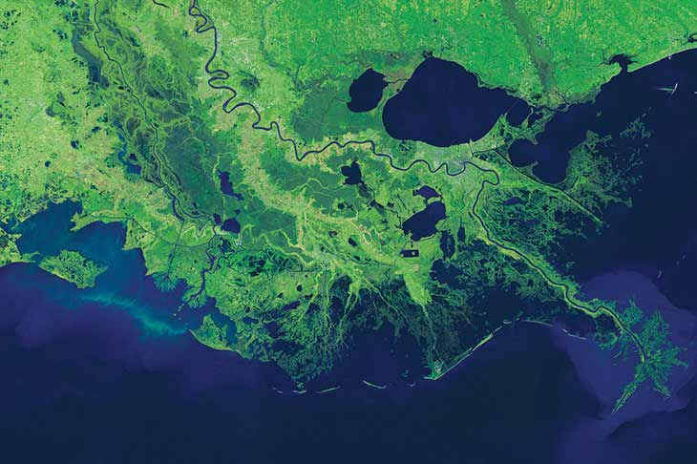
TERREBONNE LEVEE & CONSERVATION DISTRICT
ST. TAMMANY LEVEE, DRAINAGE & CONSERVATION DISTRICT BOARD MEETING
TLCD PROJECT UPDATES
JULY 17, 2024

Slide 2
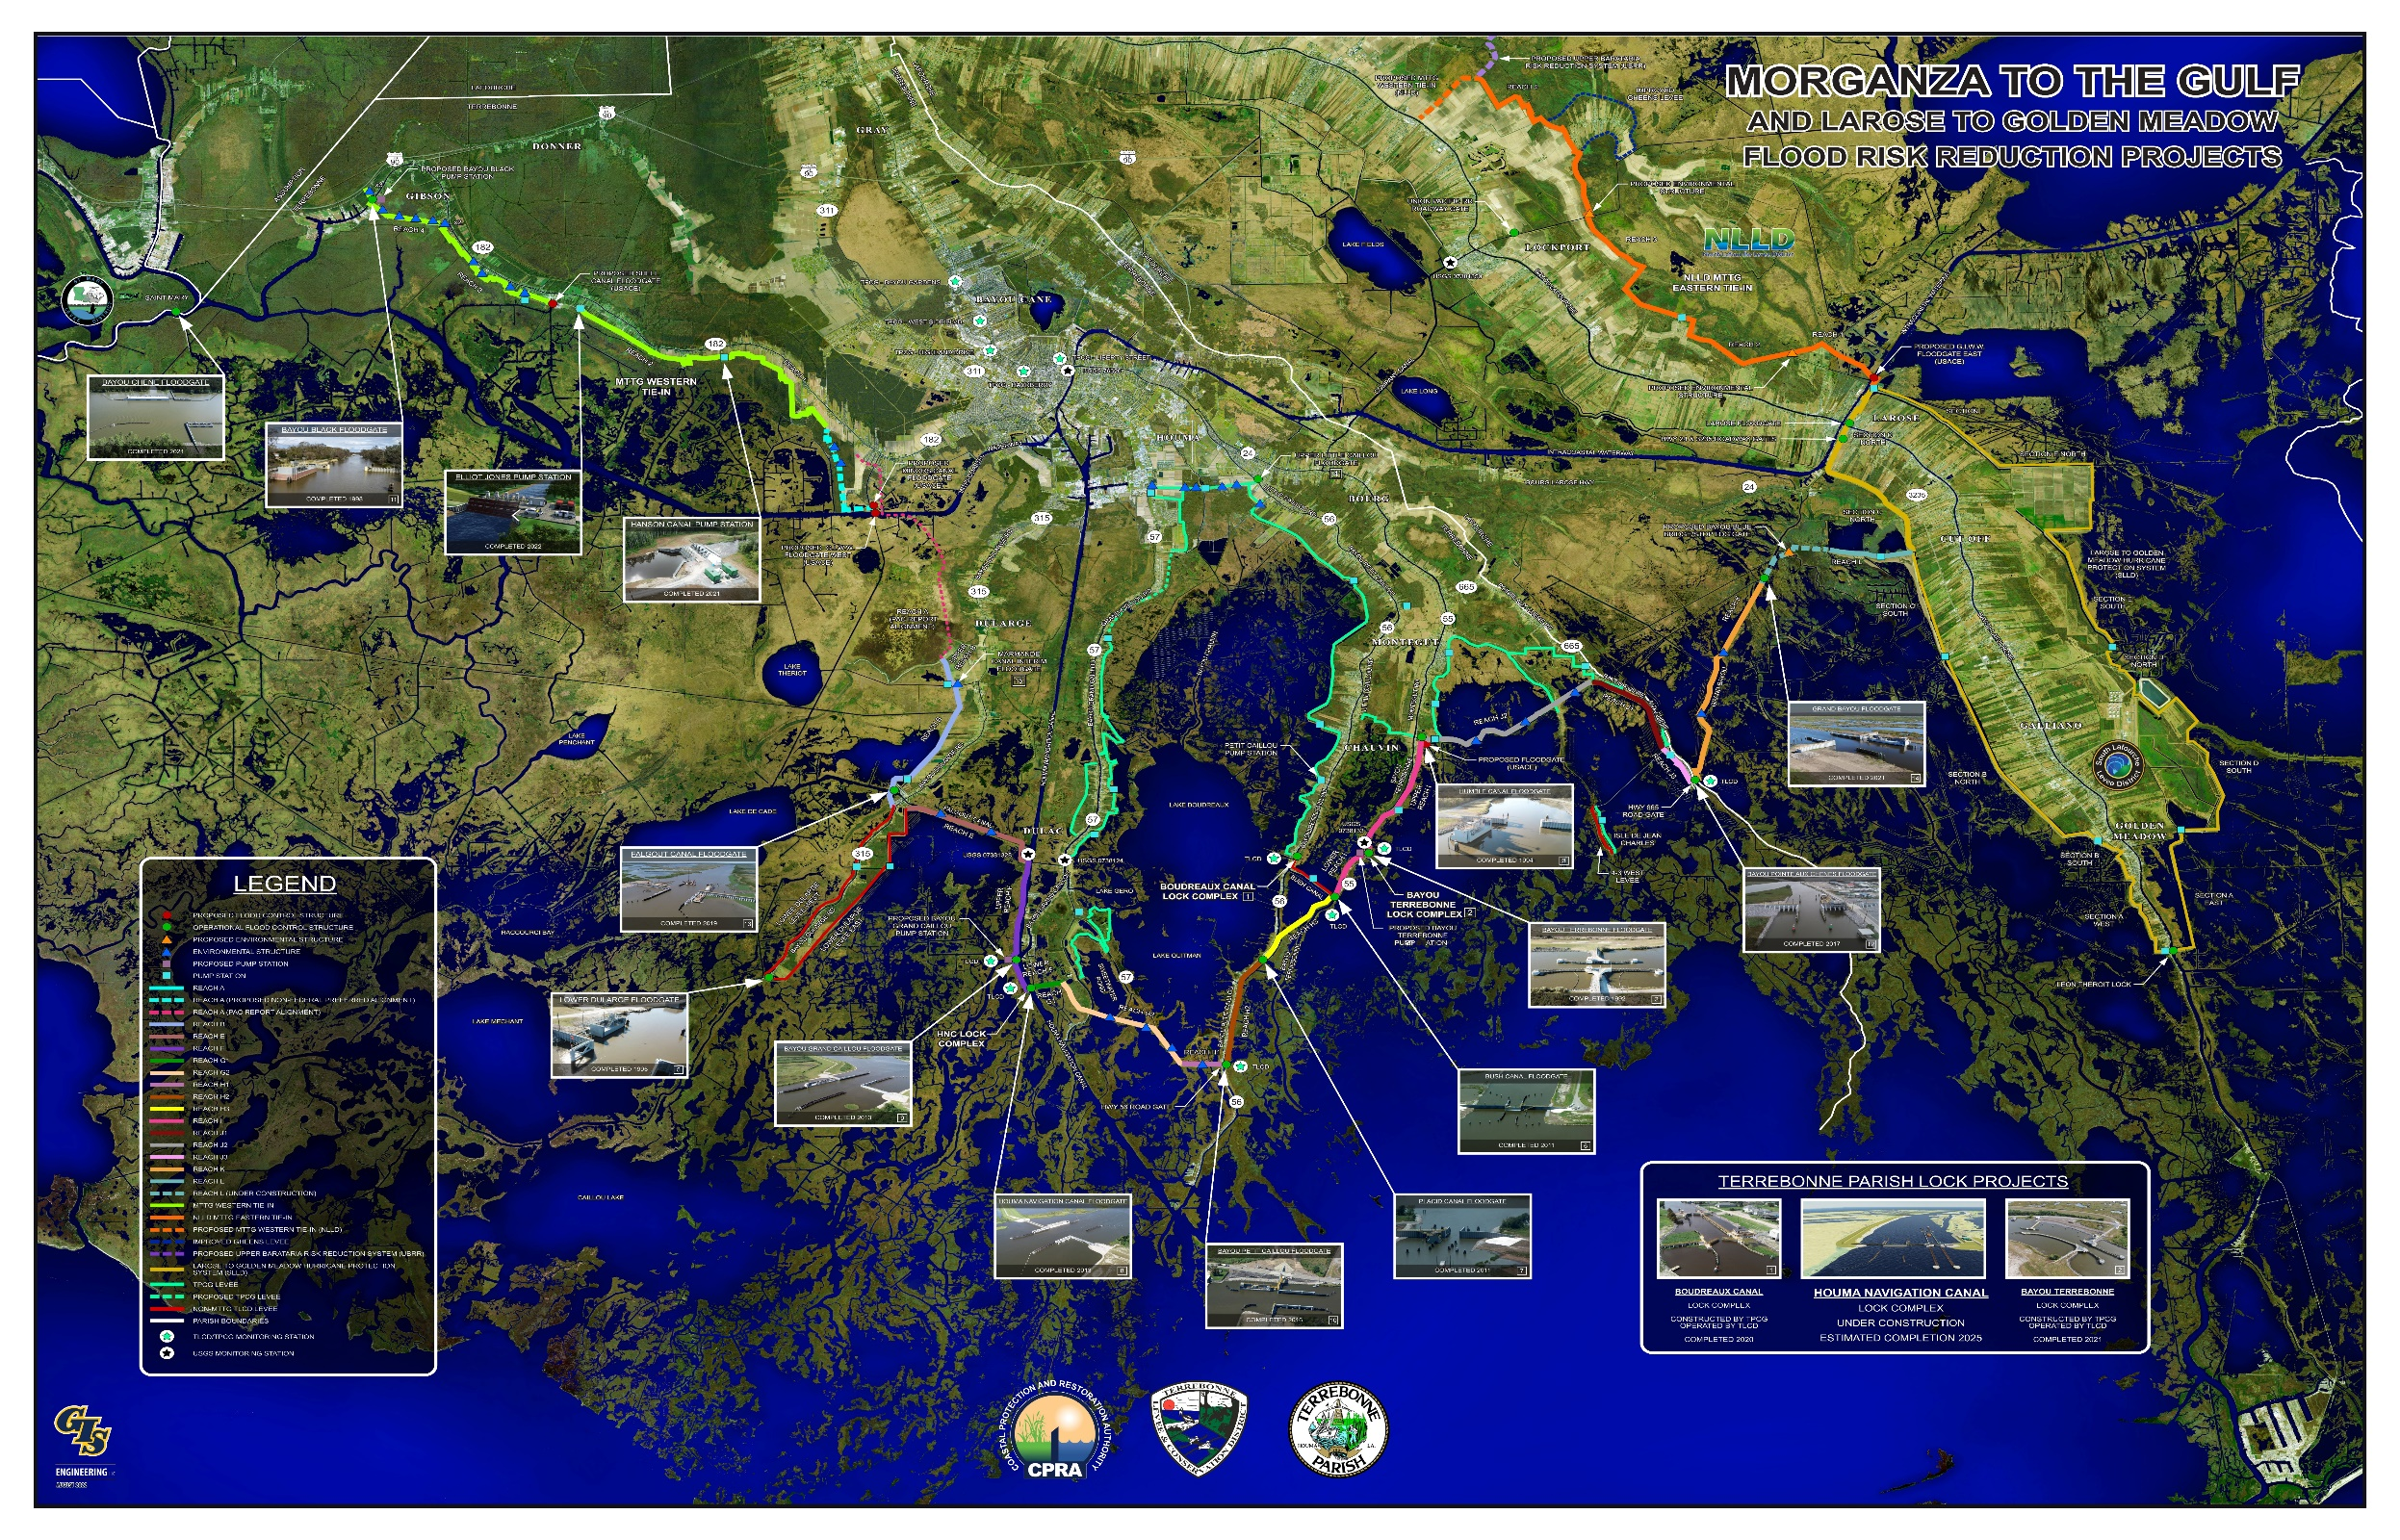
MORGANZA TO THE GULF TIMELINE

Slide 3
IN-HOUSE MITIGATION PROJECTS

Slide 4
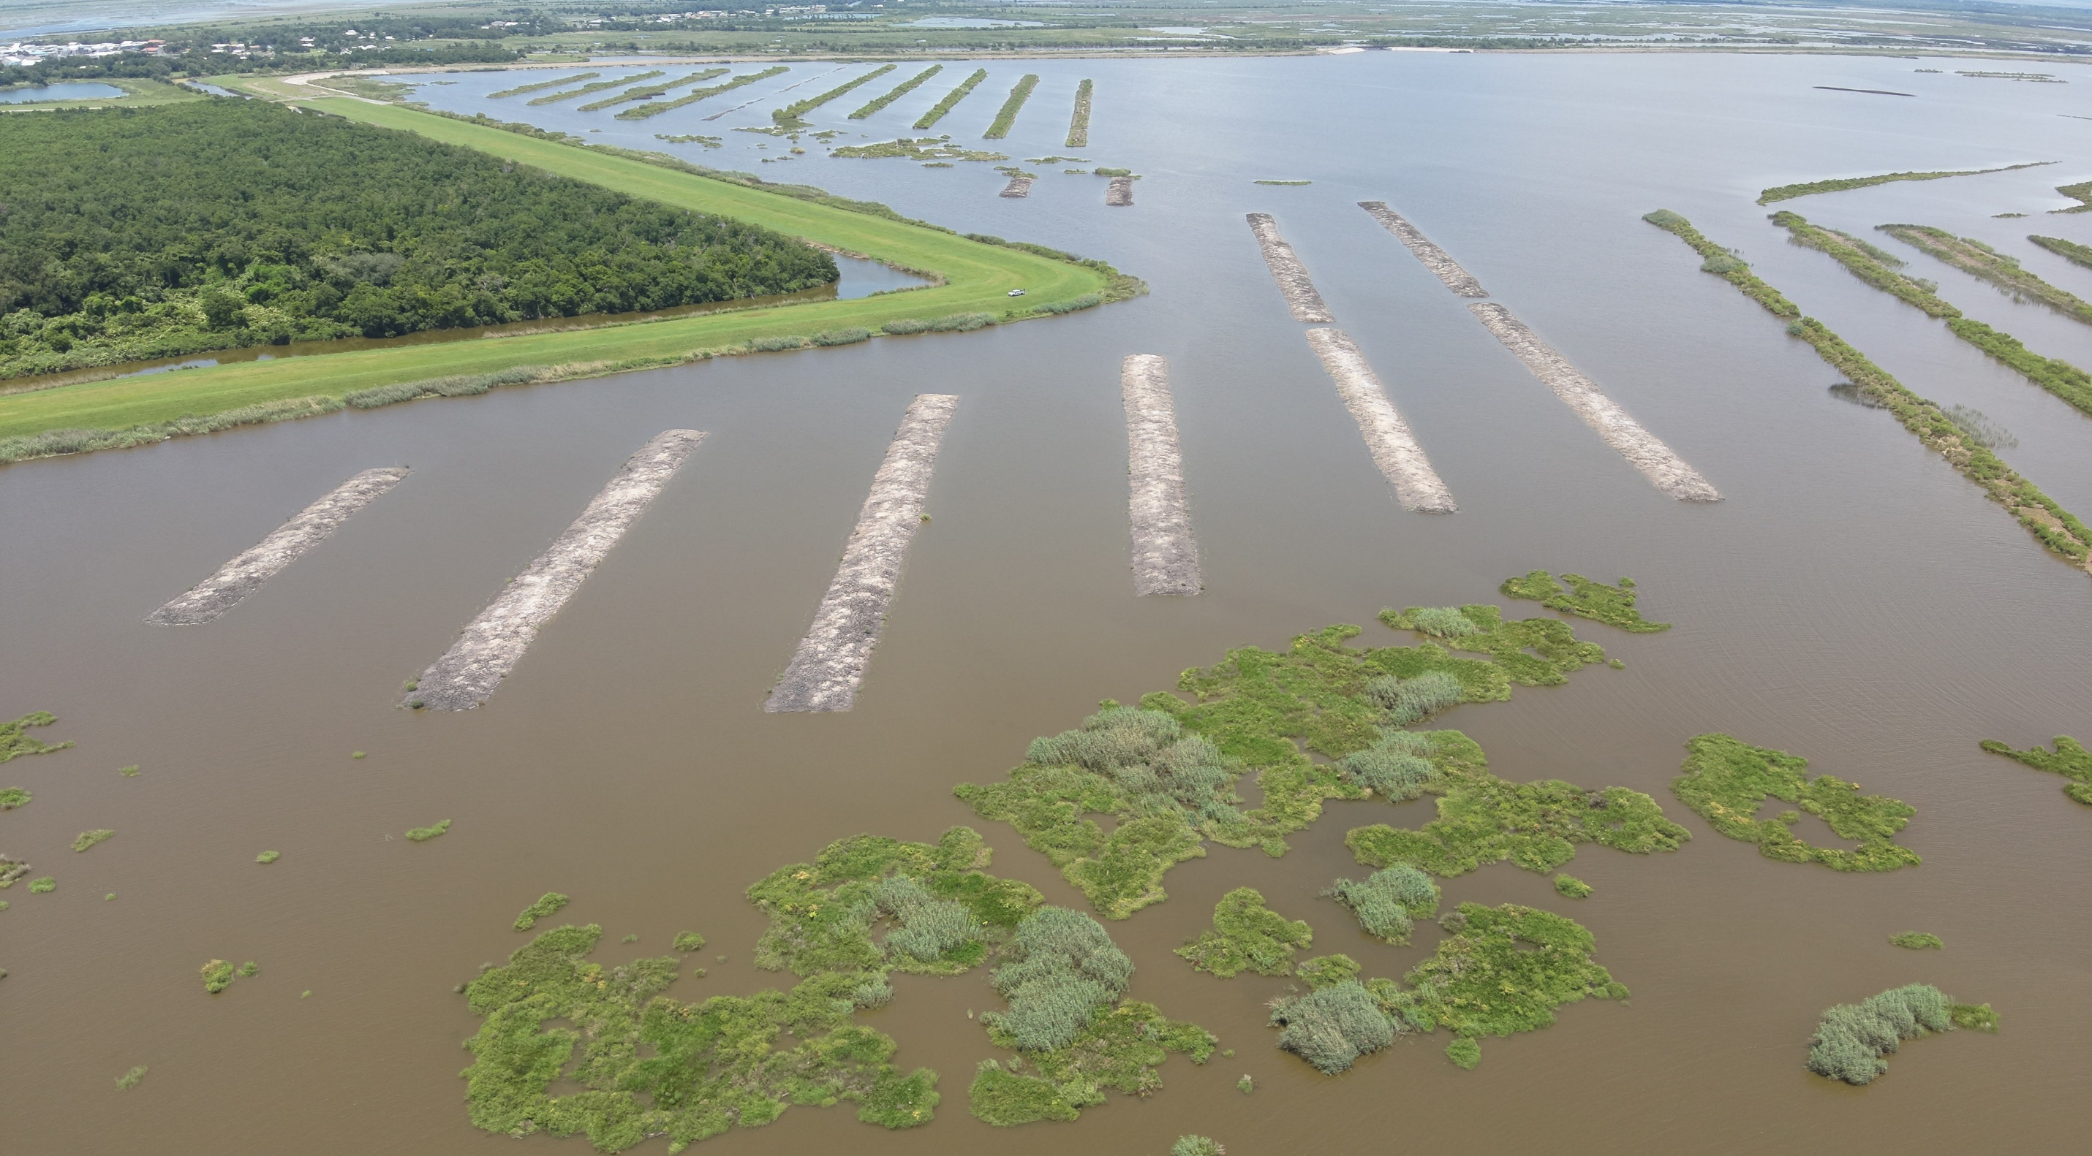
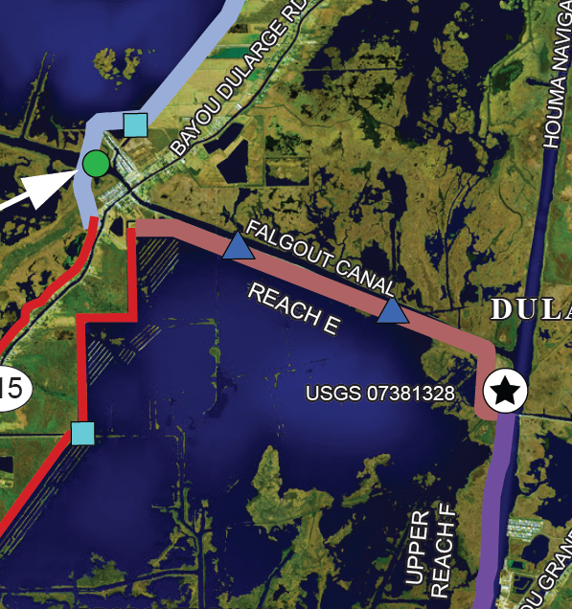
DULARGE EAST TERRACING – IN CONSTRUCTION

Slide 5
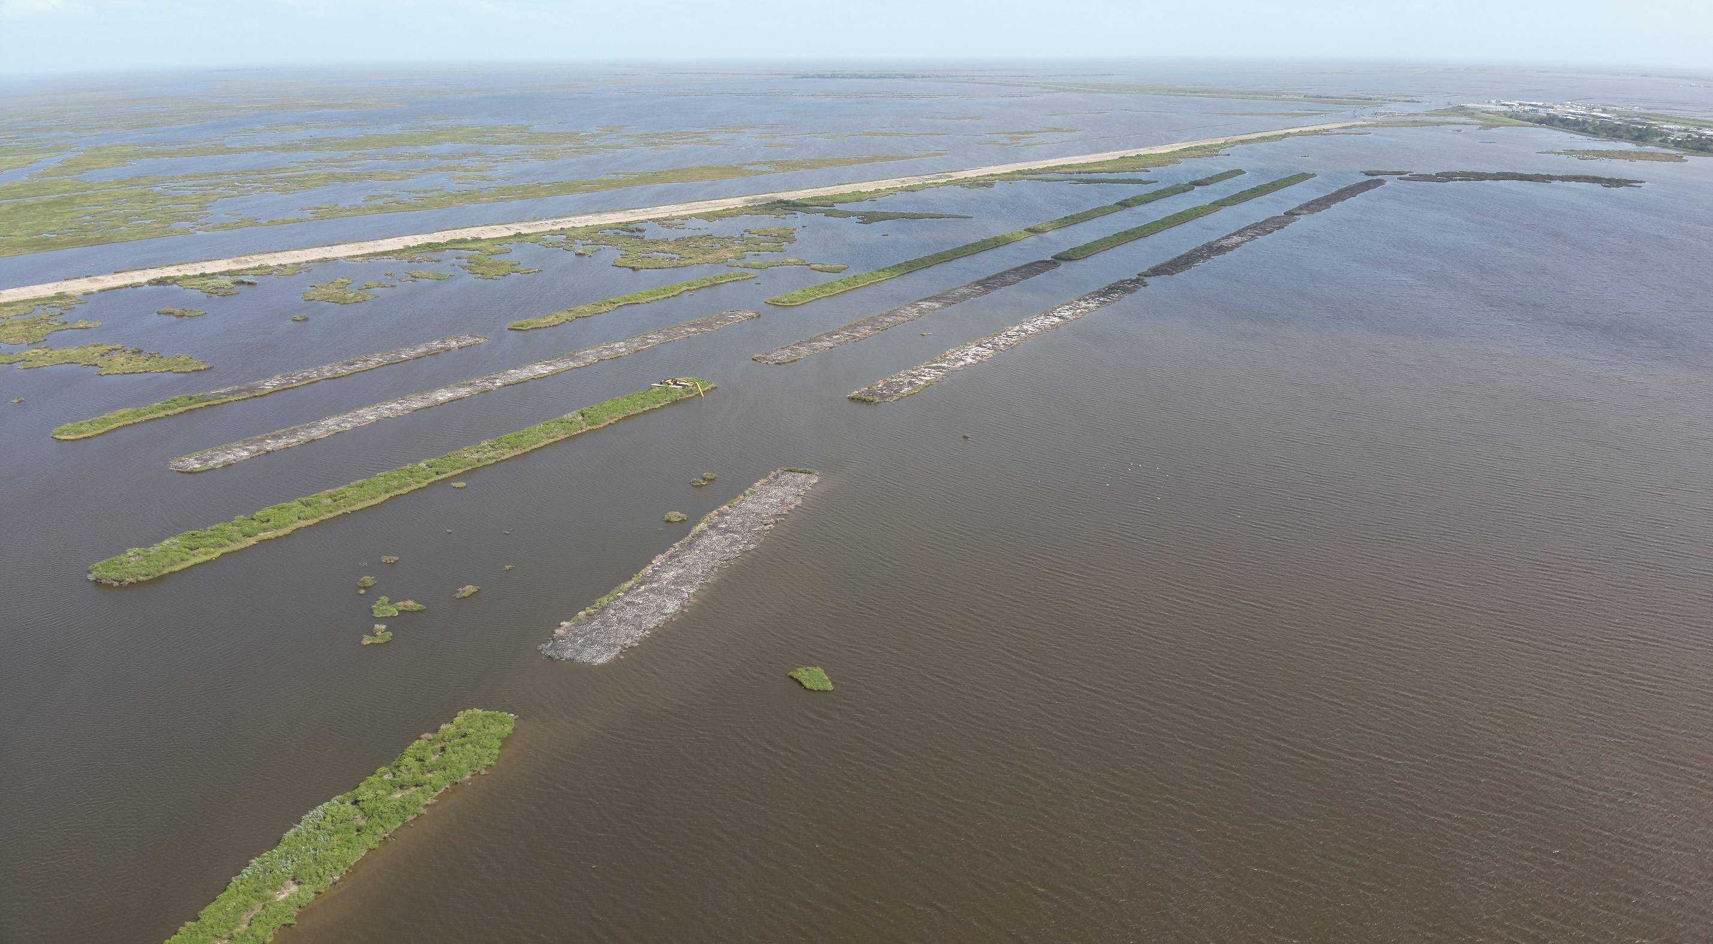
REACH K TERRACING REPAIRS – IN CONSTRUCTION

Slide 6
POINTE AUX CHENES WILDLIFE MANAGEMENT AREA
2007
INTERIOR MARSH BENEFITS OF MTG LEVEE SYSTEM
2016

Slide 7
HNC LOCK COMPLEX

Slide 8
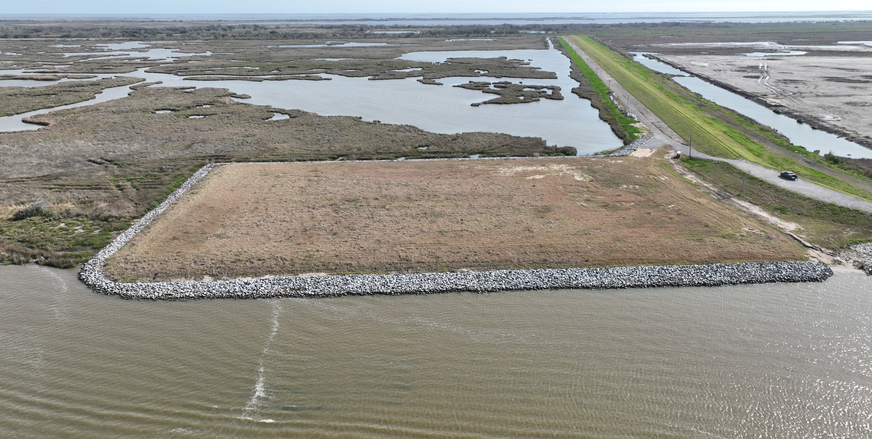
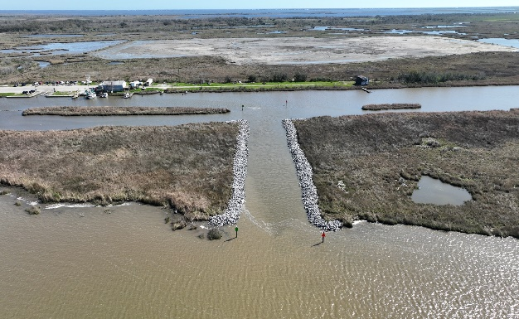
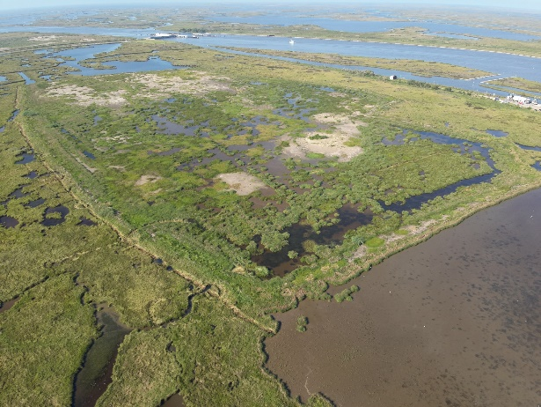
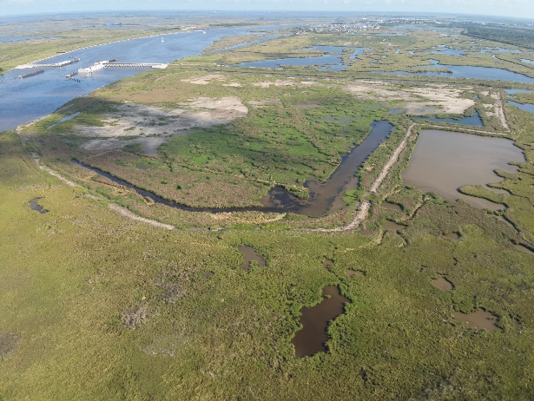
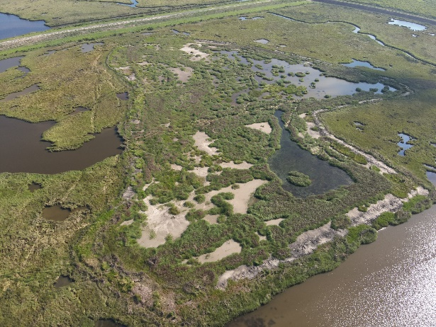
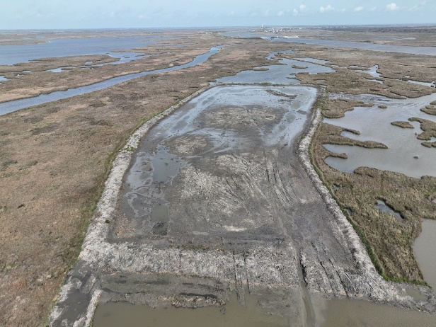
HNC LOCK COMPLEX – PHASE 1 COMPLETE
Engineer: Aptim
Contractor: Sealevel Construction, Inc.
Total Cost: $11.5 Million
Funded By: RESTORE Act
Total Dredge: 1.1 Million Cubic Yards
Total Mitigation: 143 Acres - Marsh Creation
MARINA ACCESS CHANNEL
OPERATIONS AREA PRELOAD
MARSH CREATION AREA NO. 1
MARSH CREATION AREA NO. 2
MARSH CREATION AREA NO. 3
MARSH CREATION AREA NO. 4

Slide 9
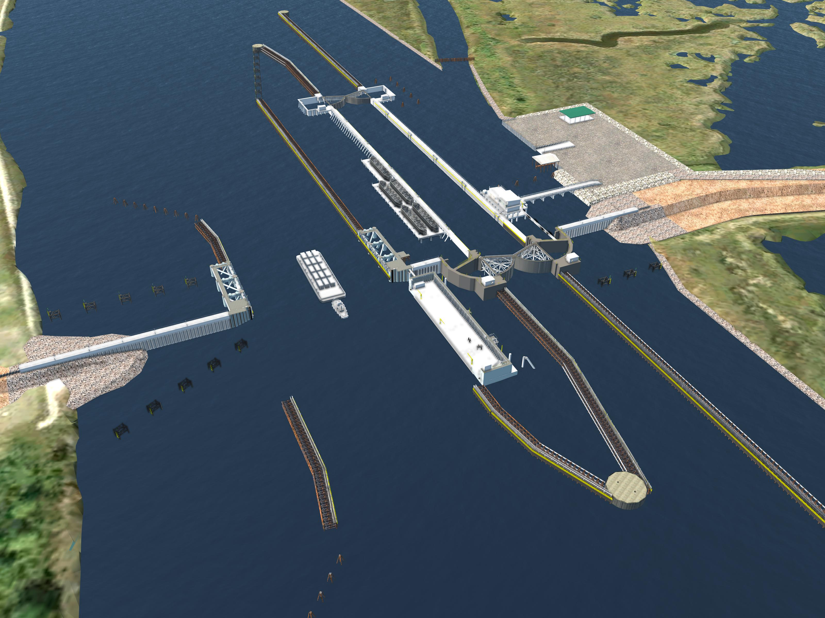
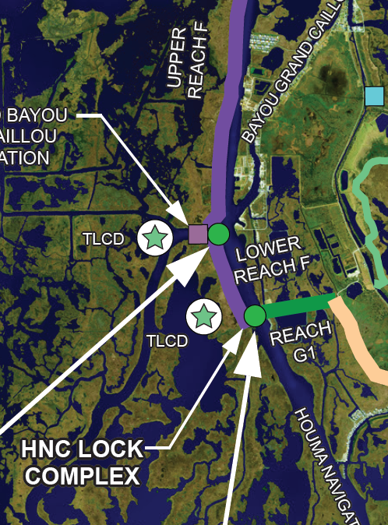
HNC LOCK COMPLEX – PHASE 2 IN CONSTRUCTION
Engineer: Aptim
Contractor: Sealevel Construction, Inc.
Notice to Proceed: June 3, 2024
Original Cost: $394.6 Million
Cost Reductions: $70.6 Million
Current Cost: $324 Million
Construction Time: 1,400 Days
Estimated Completion: Mid 2028
Funded By: RESTORE Act

Slide 10
FLOOD CONTROL STRUCTURE PROJECTS

Slide 11
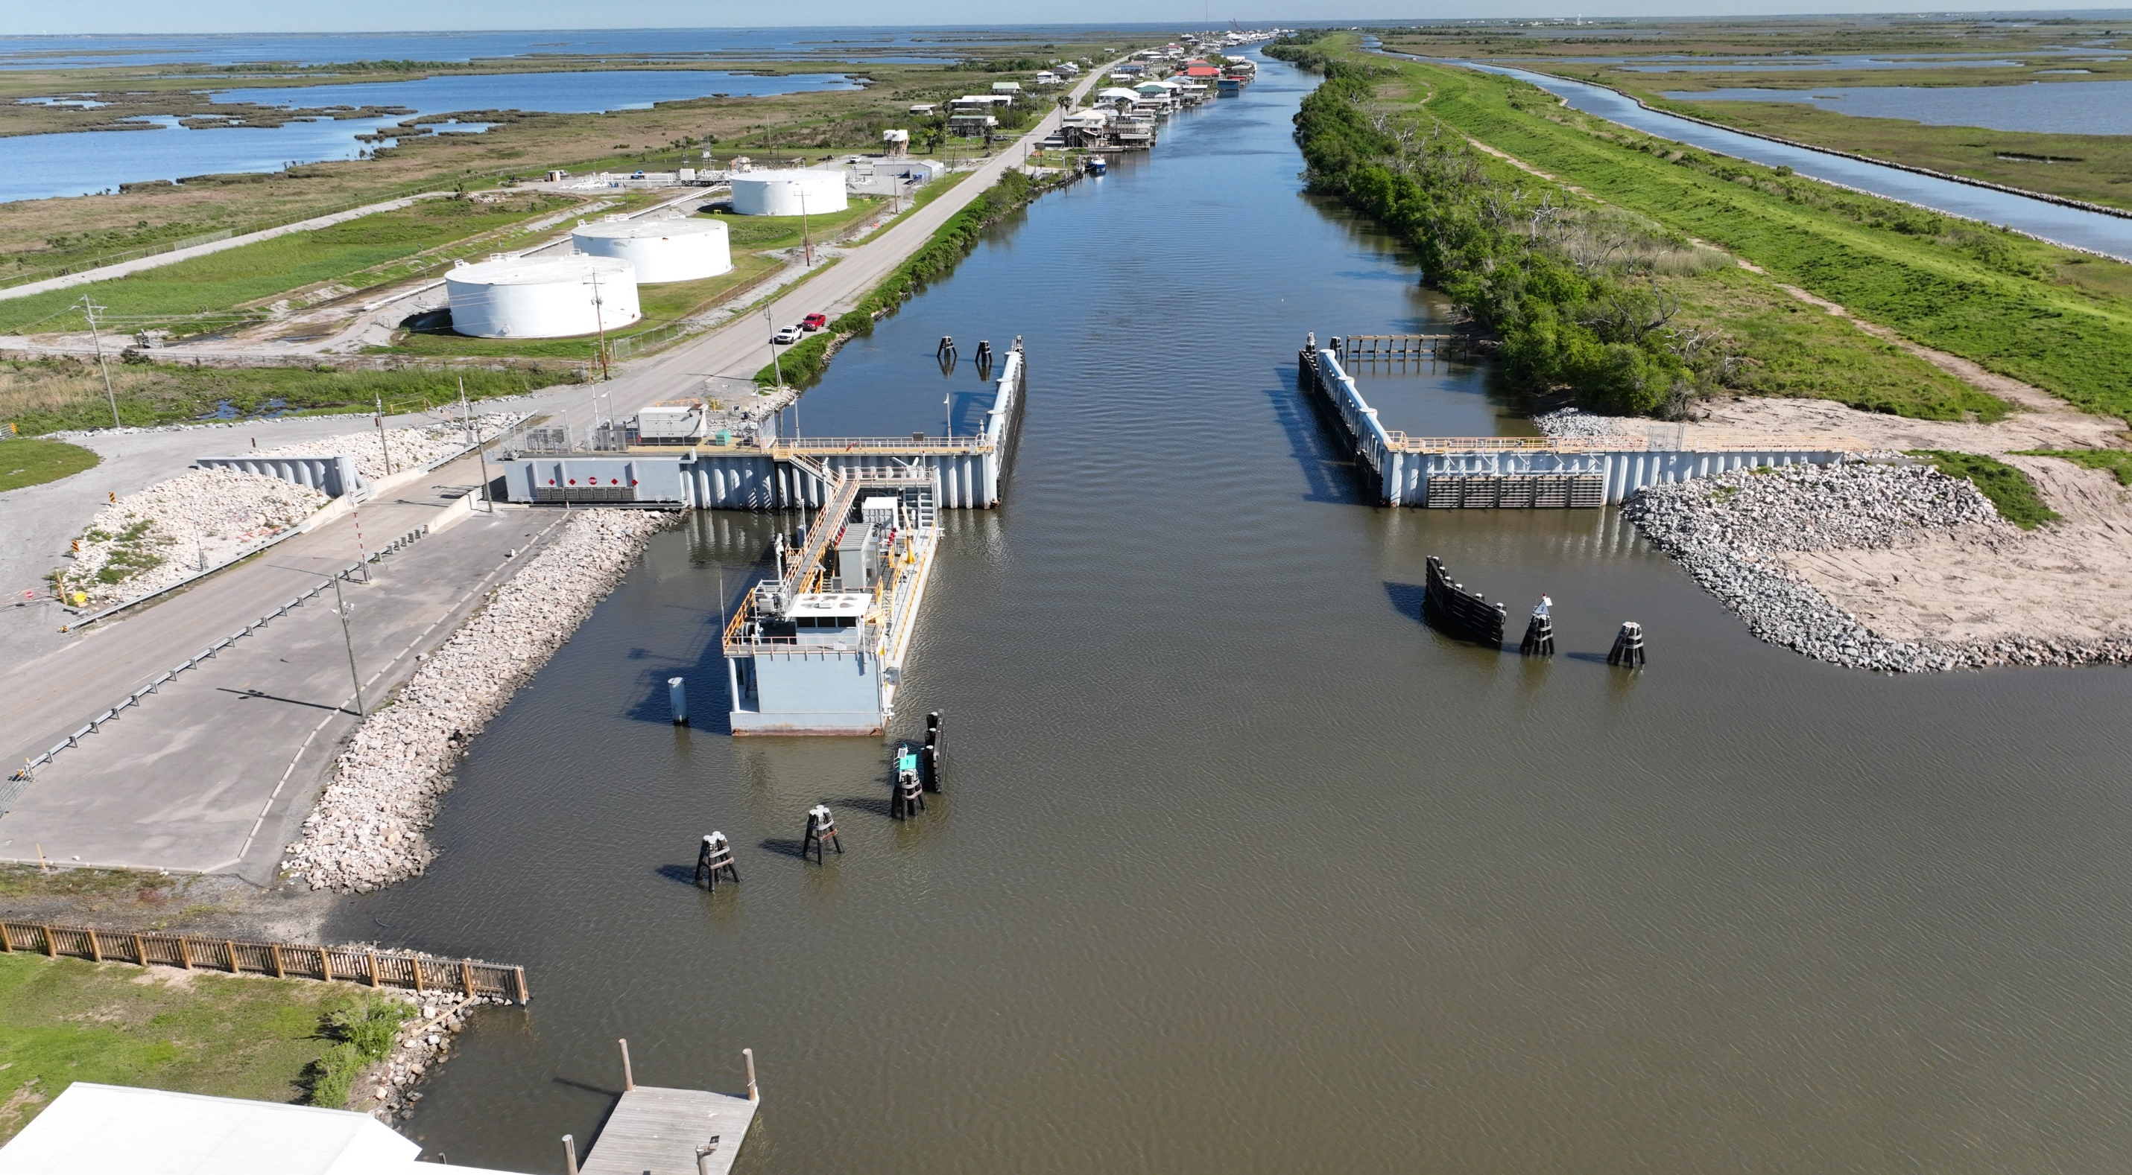
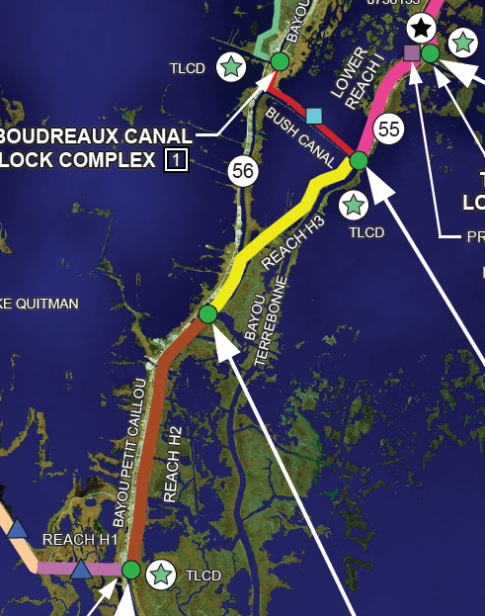
BAYOU PETIT CAILLOU FLOODGATE IMPROVEMENTS – COMPLETE
Engineer: GIS Engineering, LLC
Contractor: Sealevel Construction, Inc.
Total Cost: $2.2 Million
Funded By: FEMA
Features: (5) 8’x8’ & (7) 3’x3’ Flap Gates

Slide 12
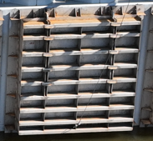
BUSH & PLACID FLOODGATE IMPROVEMENTS – IN DESIGN
Engineer: GIS Engineering, LLC
Contractor: TBD
Total Cost: Estimated $6 Million
Funded By: FEMA
Features: (5) 8’x8’ Flap Gates at Placid
(10) 8’x8’ Flap Gates at Bush

Slide 13
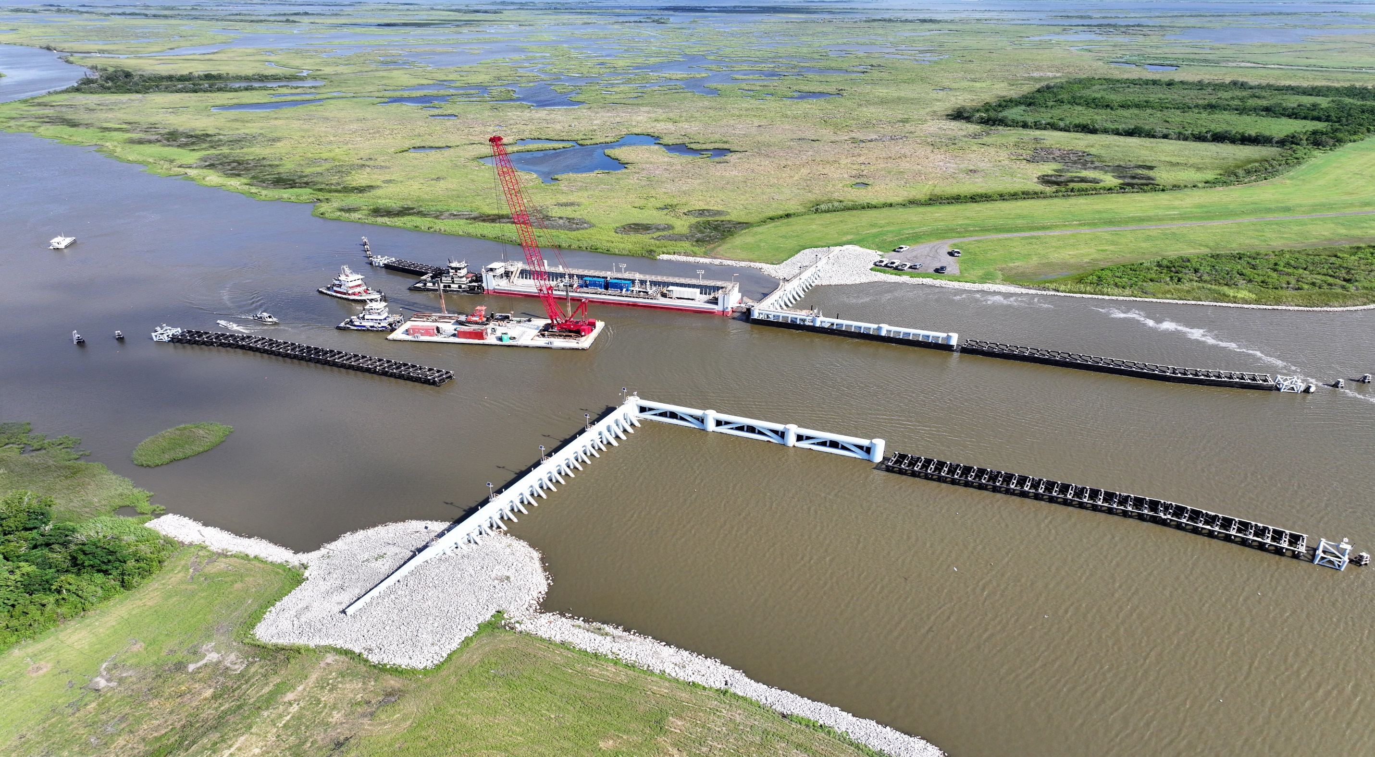
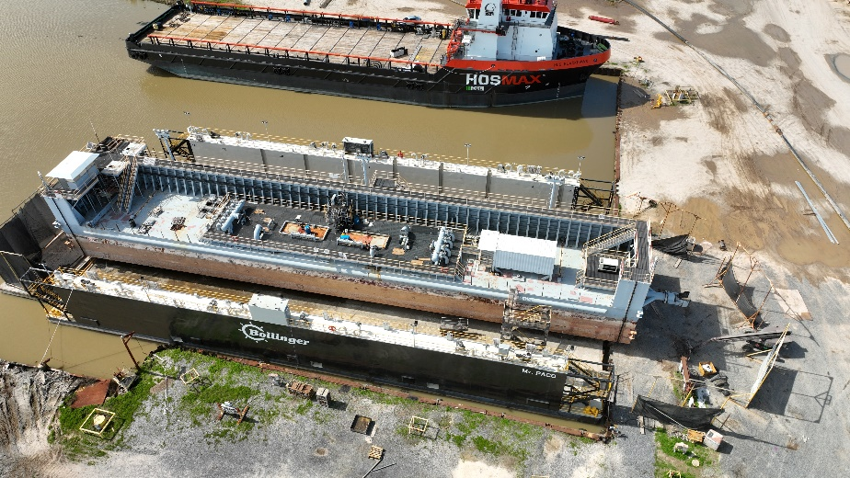
BAYOU GRAND CAILLOU FLOODGATE MAINTENANCE – COMPLETE
Engineer: Delta Coast Consultants, LLC GIS Engineering, LLC
Contractor: Sealevel Construction, Inc.
Total Cost: $2.2 Million
Funded By: TLCD
Features: Maintenance Dry Dock

Slide 14
LEVEE IMPROVEMENT PROJECTS

Slide 15
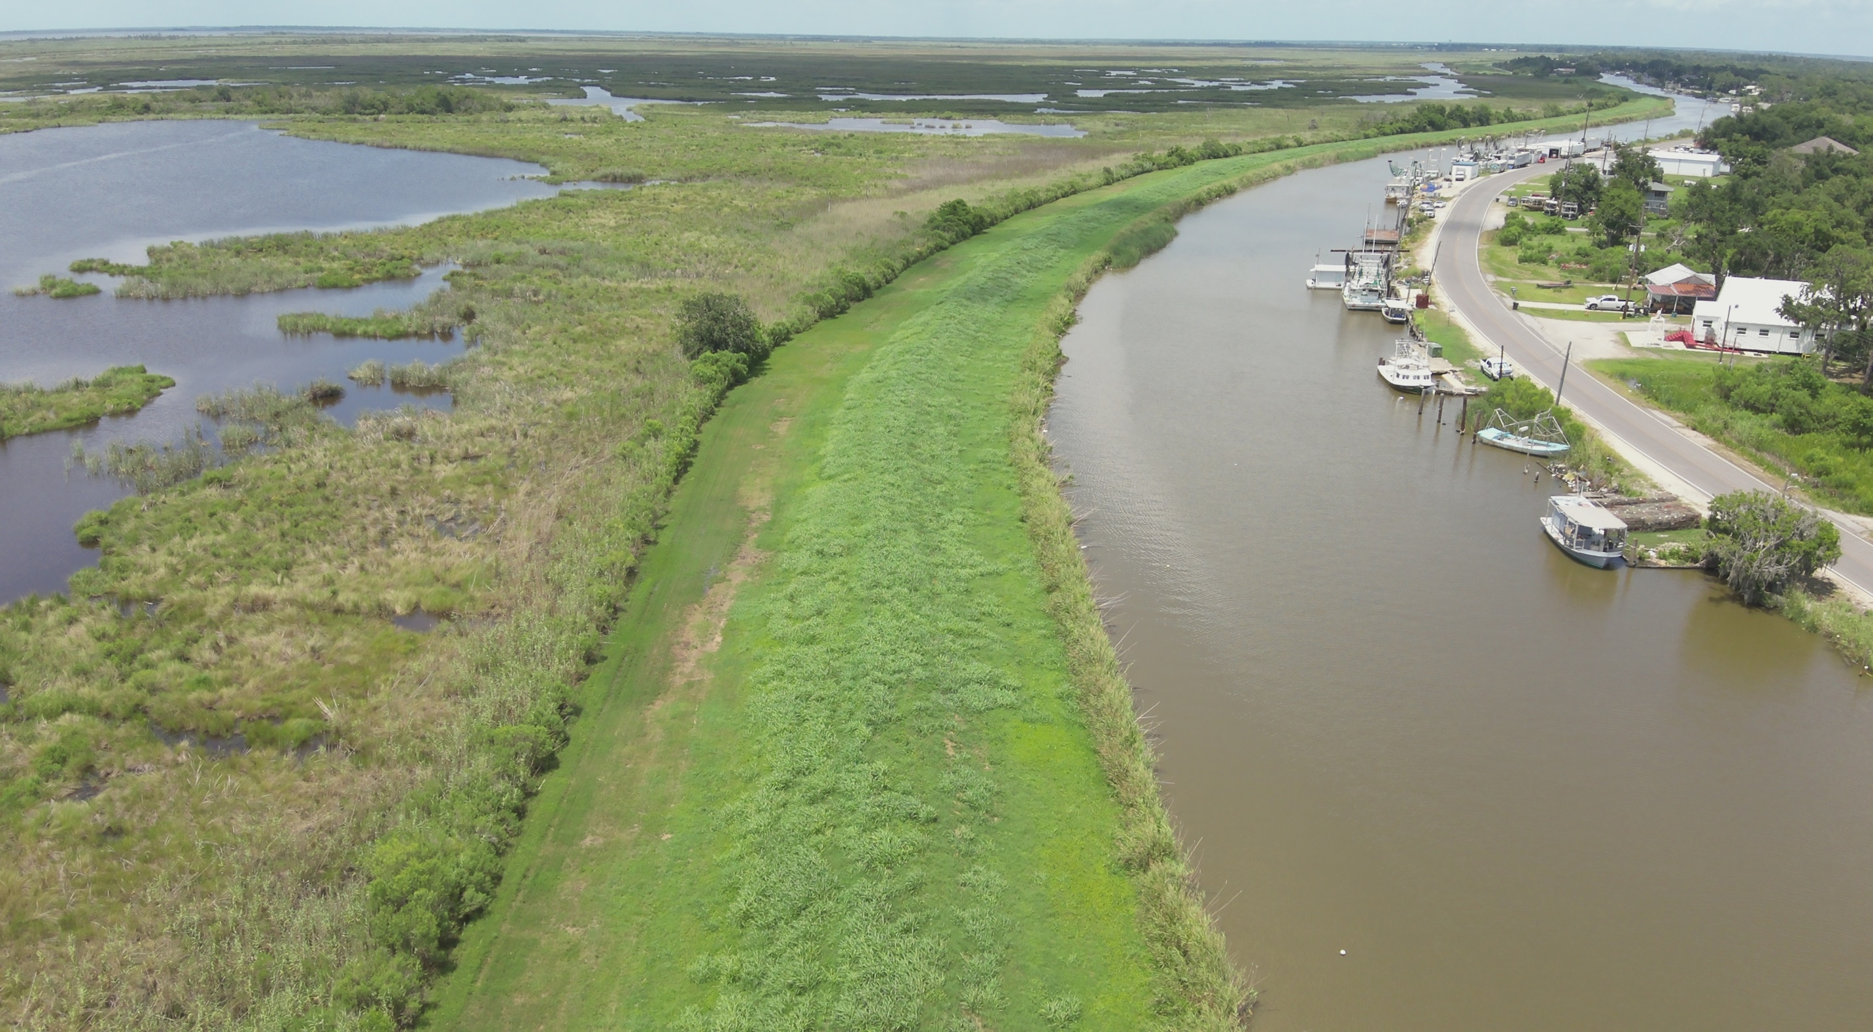
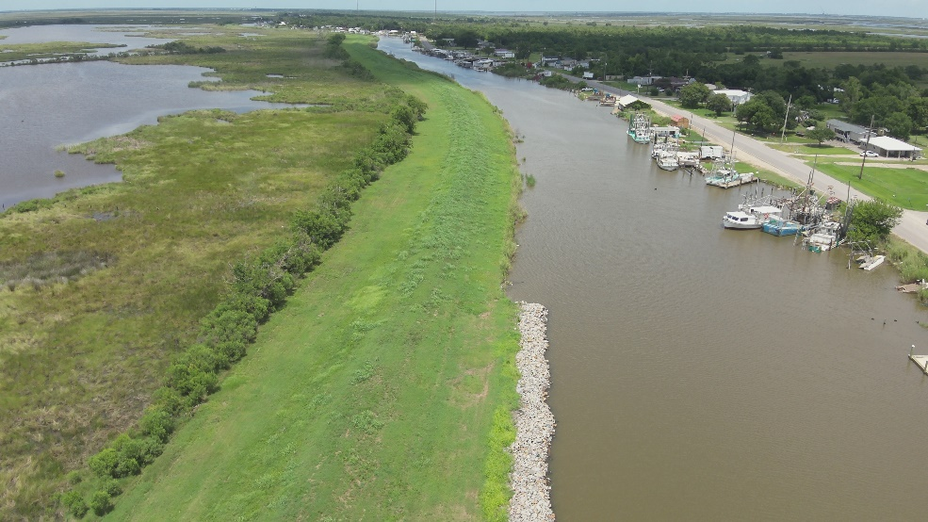
NON-MTG – DULARGE WEST LEVEE BETTERMENT (+9) – PENDING AWARD

Slide 16
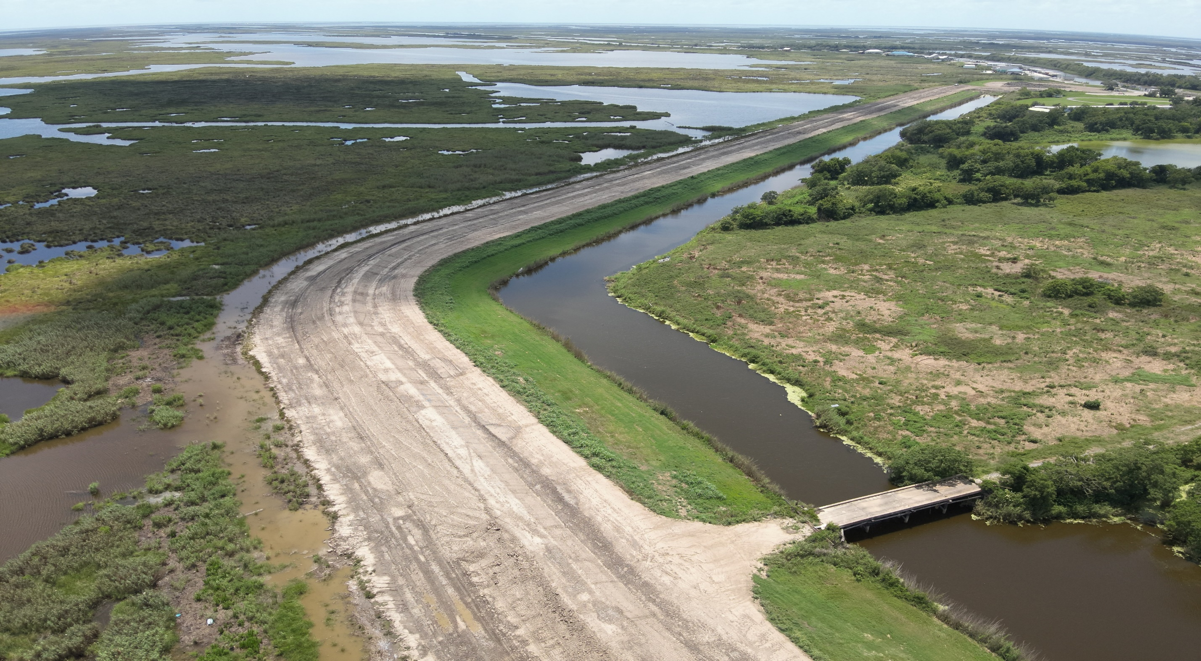
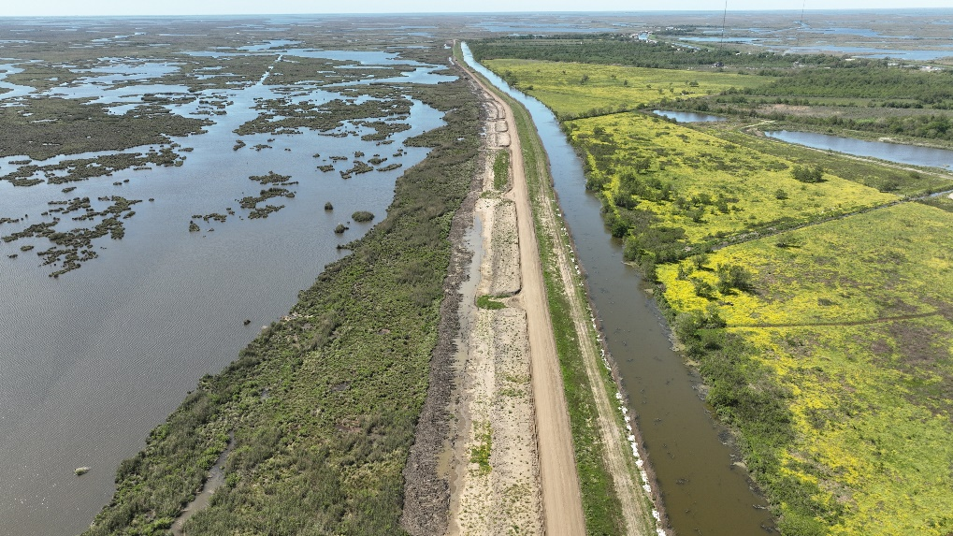
NON-MTG – DULARGE EAST LEVEE BETTERMENT (+12) – IN CONSTRUCTION

Slide 17
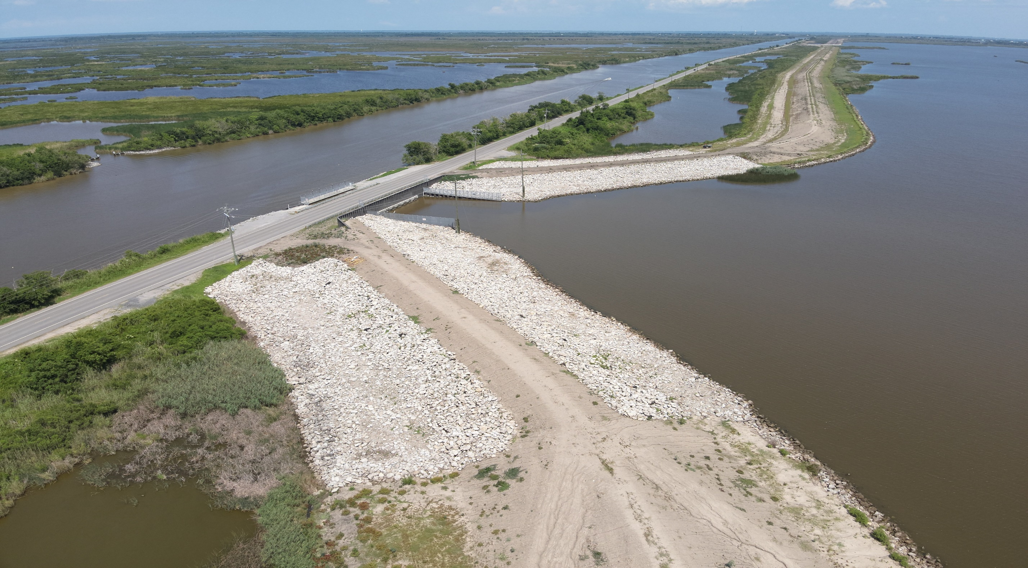
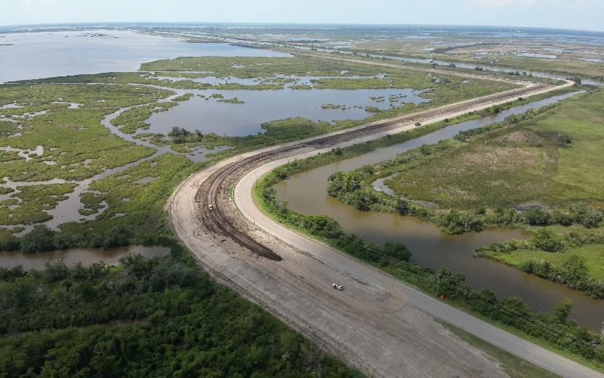
REACH E LEVEE IMPROVEMENTS (+15) – IN CONSTRUCTION
Engineer: Delta Coast Consultants, LLC
Contractor: Onshore Materials, LLC
Total Cost: $11 Million
Funded By: CPRA
Total Fill: 530k Cubic Yards
Completion: July 2024

Slide 18
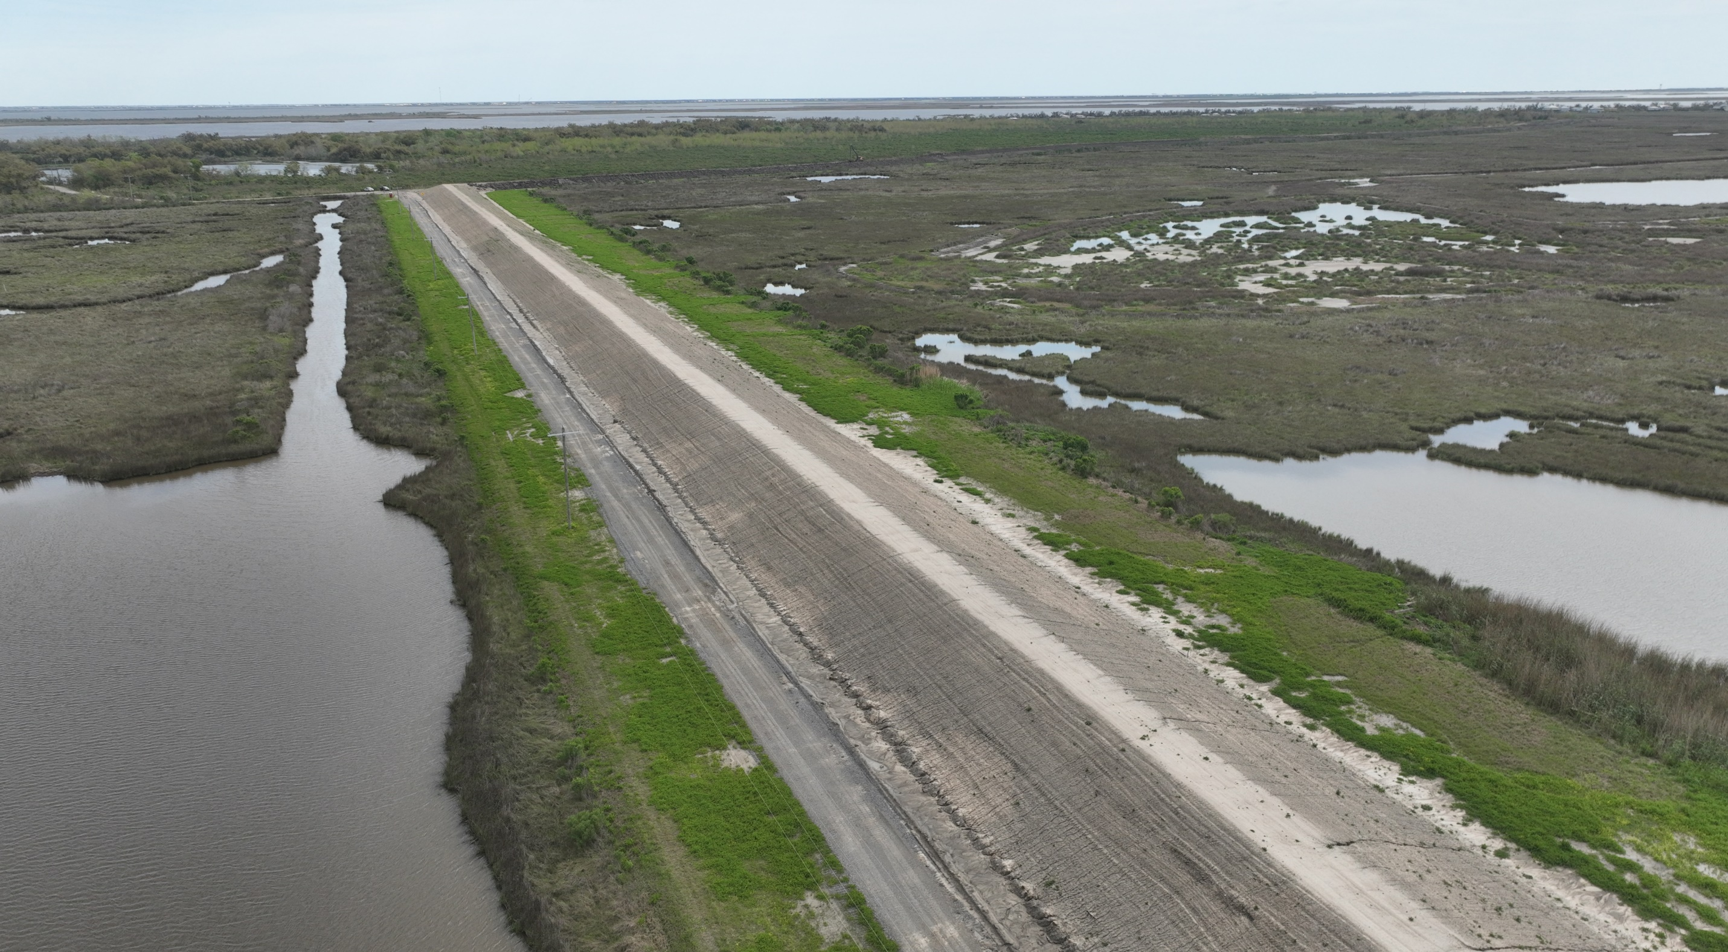
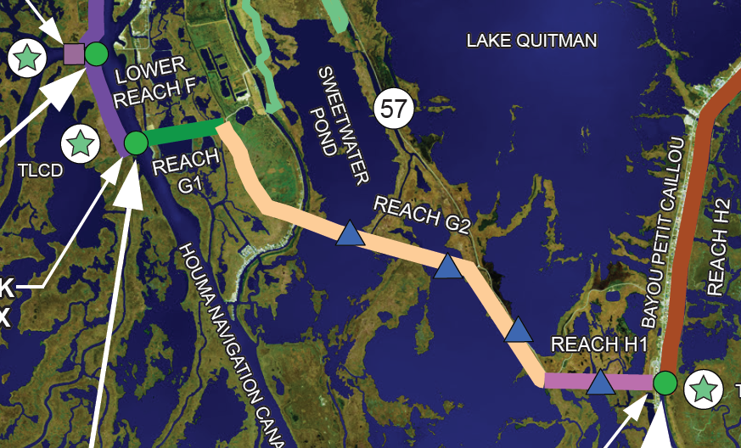
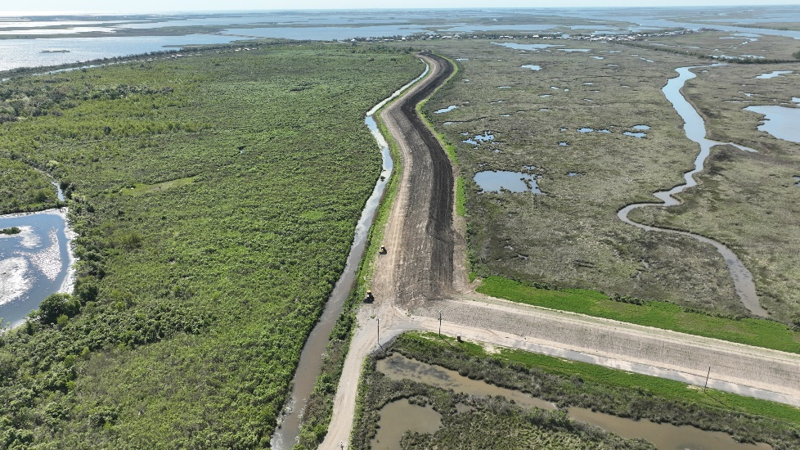
REACH G-1/G-2A LEVEE IMPROVEMENTS (+15) – IN CONSTRUCTION
Engineer: Delta Coast Consultants, LLC
Contractor: Onshore Materials, LLC
Total Cost: $2.25 Million
Funded By: CPRA
Total Fill: 96k Cubic Yards
Completion: July 2024

Slide 19
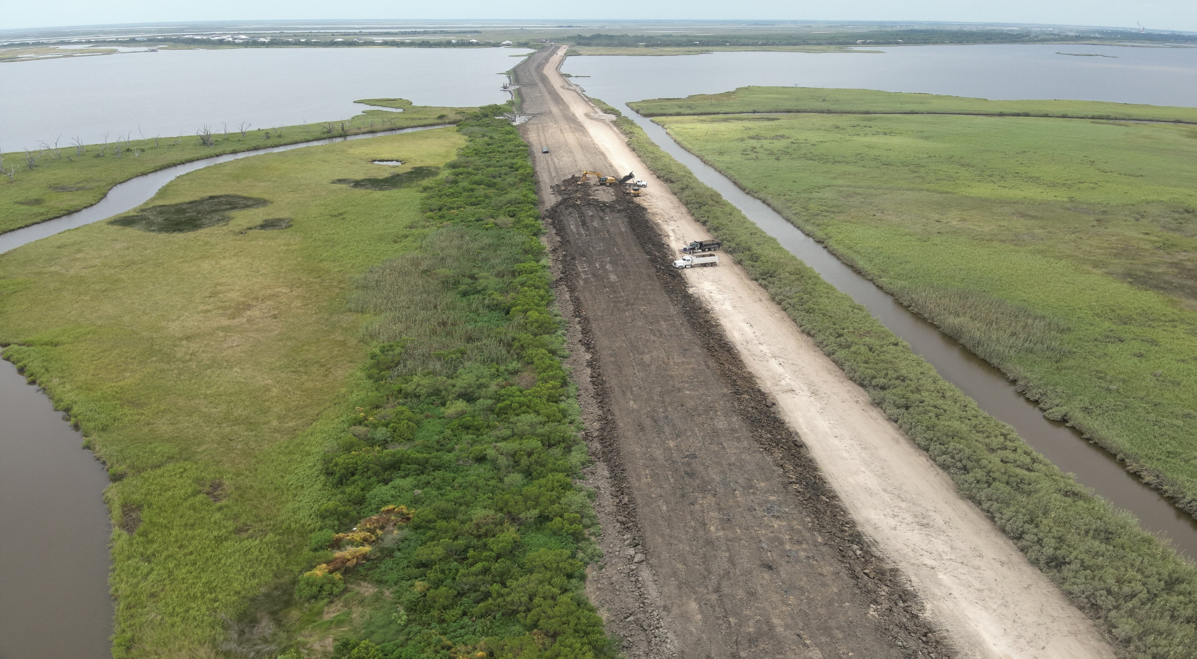
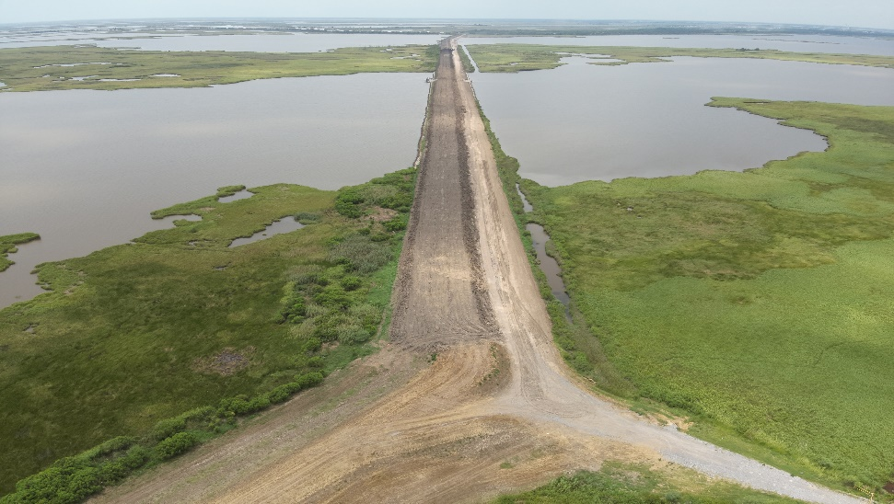
REACH G-2B LEVEE IMPROVEMENTS (+15) – IN CONSTRUCTION
Engineer: Delta Coast Consultants, LLC
Contractor: Construction Site Specialties, LLC
Total Cost: $4.5 Million
Funded By: CPRA
Total Fill: 200k Cubic Yards
Completion: Late Summer 2024

Slide 20
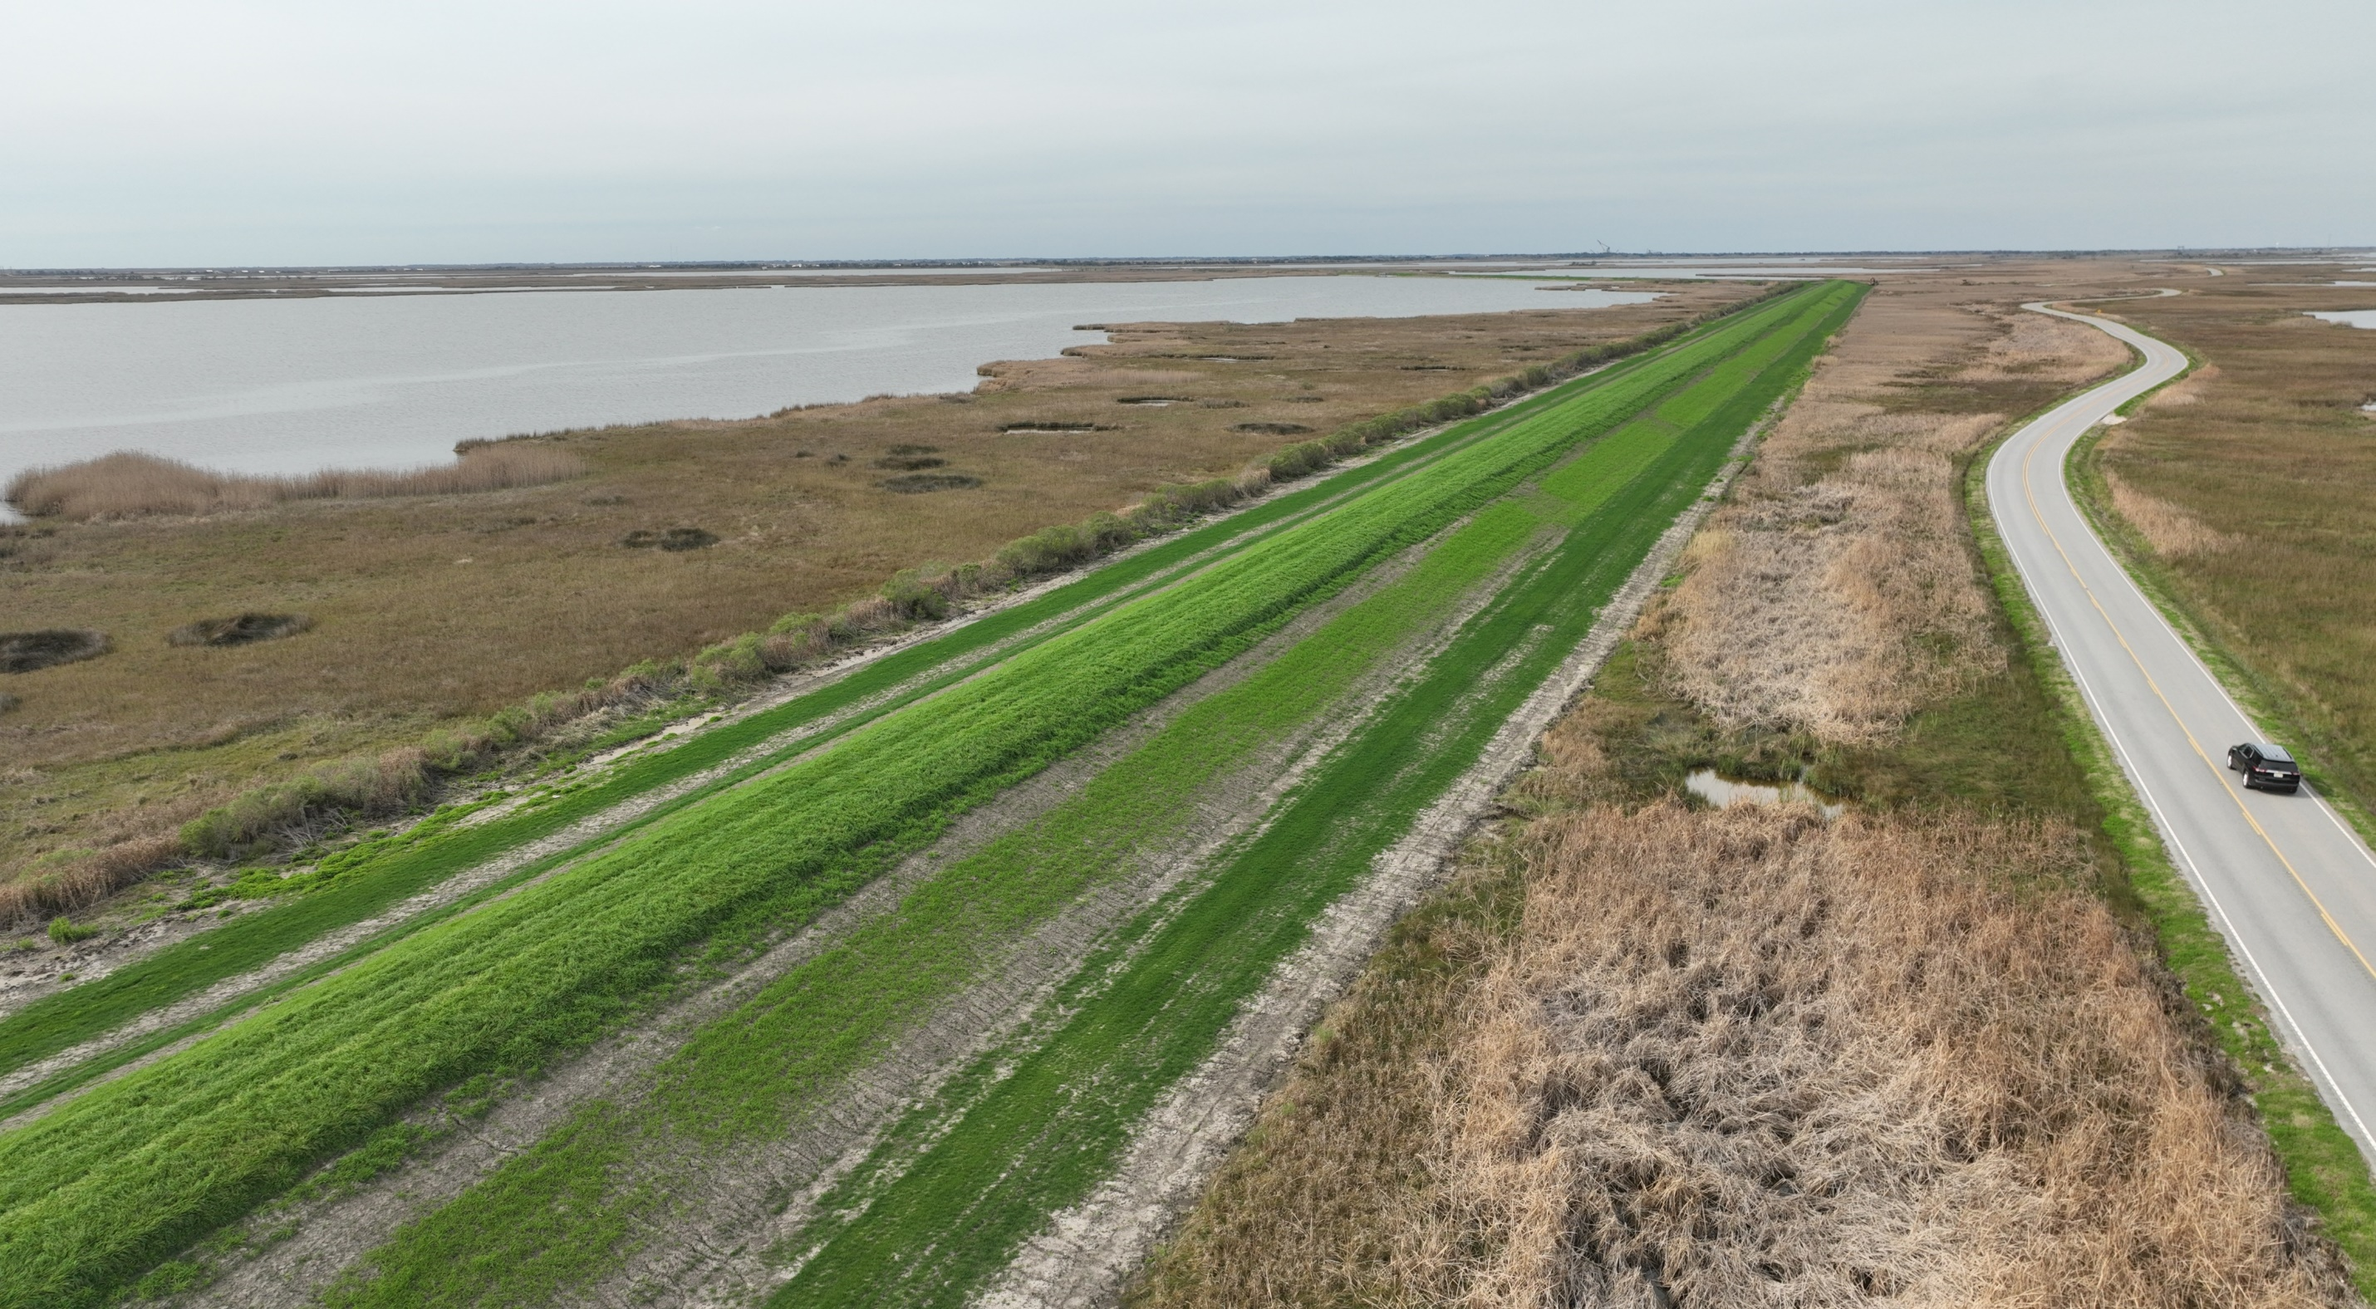
REACH G-2C LEVEE IMPROVEMENTS (+15) – COMPLETE
Engineer: Delta Coast Consultants, LLC
Contractor: Construction Site Specialties, LLC
Total Cost: $2.5 Million
Funded By: CPRA
Total Fill: 110k Cubic Yards

Slide 21
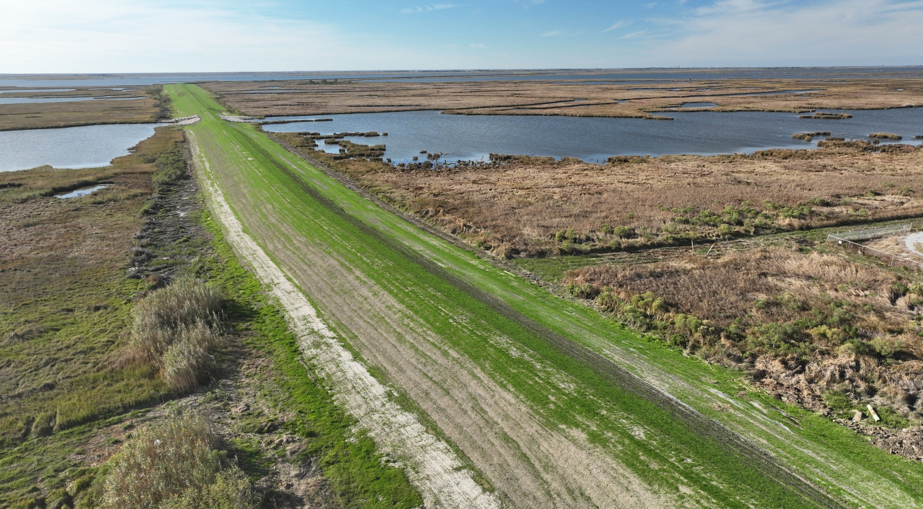
REACH H-1 LEVEE IMPROVEMENTS (+15) – COMPLETE
Engineer: GIS Engineering, LLC
Contractor: Vantage Contractors, LLC
Total Cost: $2.7 Million
Funded By: FEMA & TLCD
Total Fill: 85k Cubic Yards

Slide 22
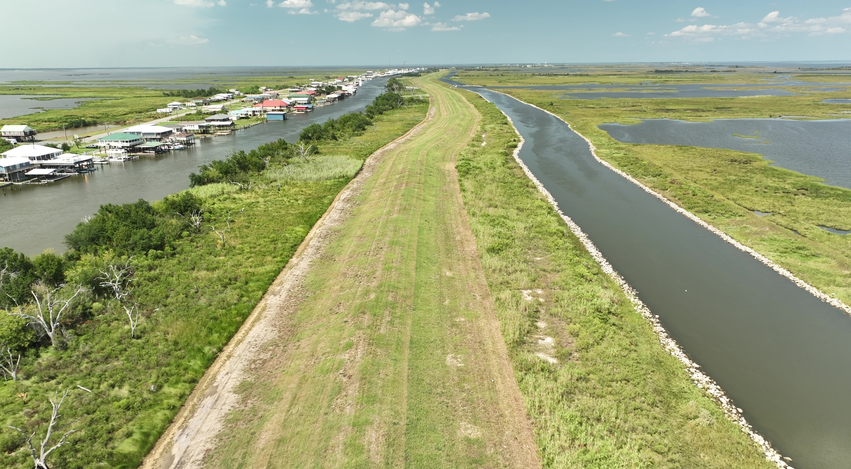
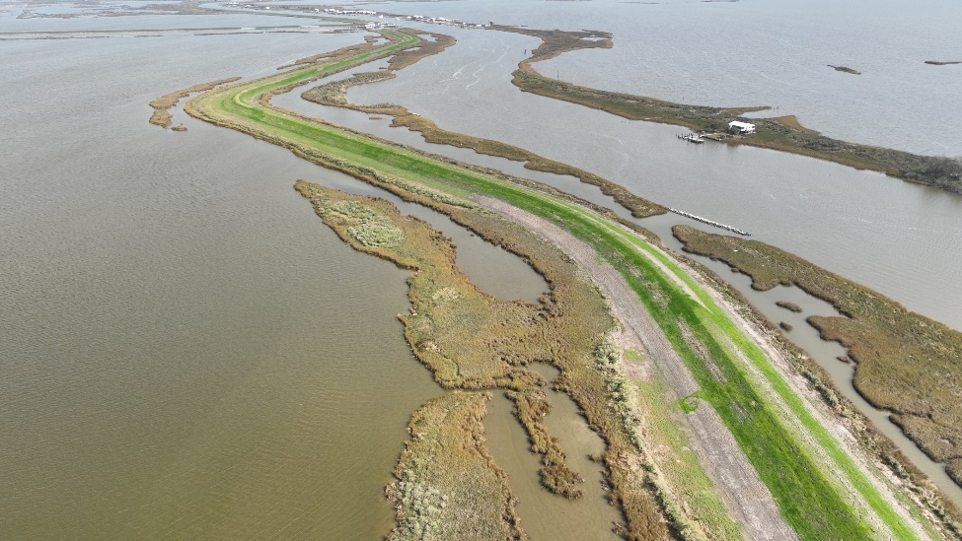
REACH H-2/H-3 LEVEE IMPROVEMENTS (+15) – IN DESIGN
Engineer: GIS Engineering, LLC
Contractor: TBD
Cost: Estimated $13 Million
Funded By: CPRA
Total Fill: 500k Cubic Yards
Bidding: Late 2024

Slide 23
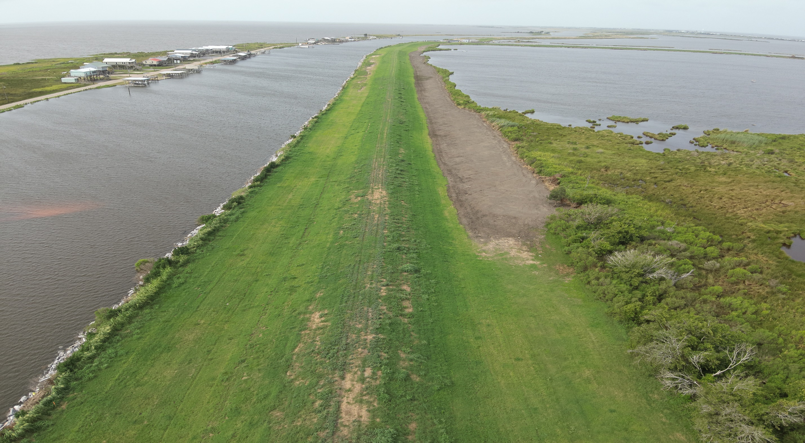
LOWER REACH I LEVEE IMPROVEMENTS (+14) – IN CONSTRUCTION
Engineer: T. Baker Smith
Contractor: Sealevel Construction, Inc.
Total Cost: $2.5 Million
Funded By: CPRA
Total Fill: 87k Cubic Yards
Completion: Late 2024

Slide 24
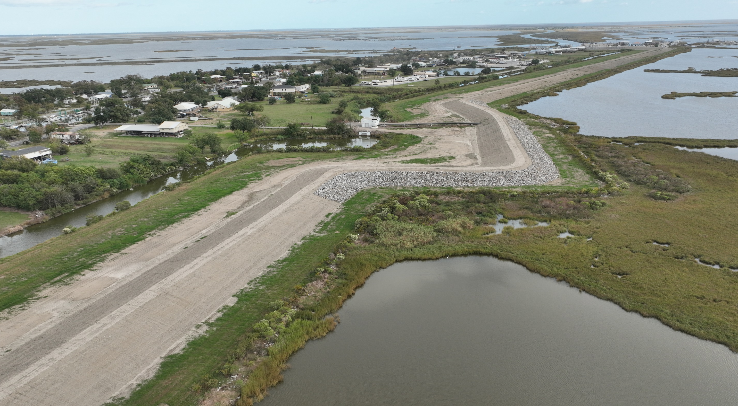
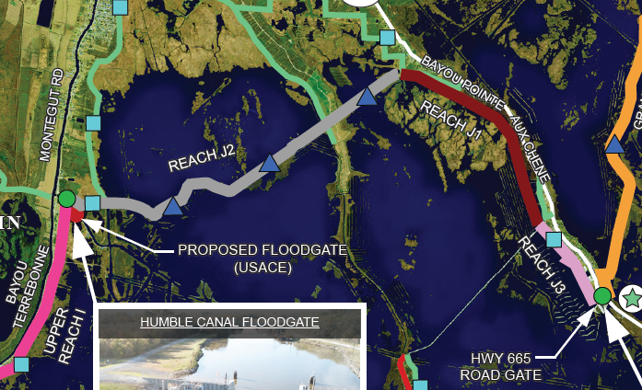
REACH J-3 LEVEE IMPROVEMENTS (+15) – COMPLETE
Engineer: All South Consulting Engineers, LLC
Contractor: Onshore Materials, LLC & Low Land Construction Co., Inc
Total Cost: $1.5 Million
Funded By: CPRA
Total Fill: 100k Cubic Yards

Slide 25
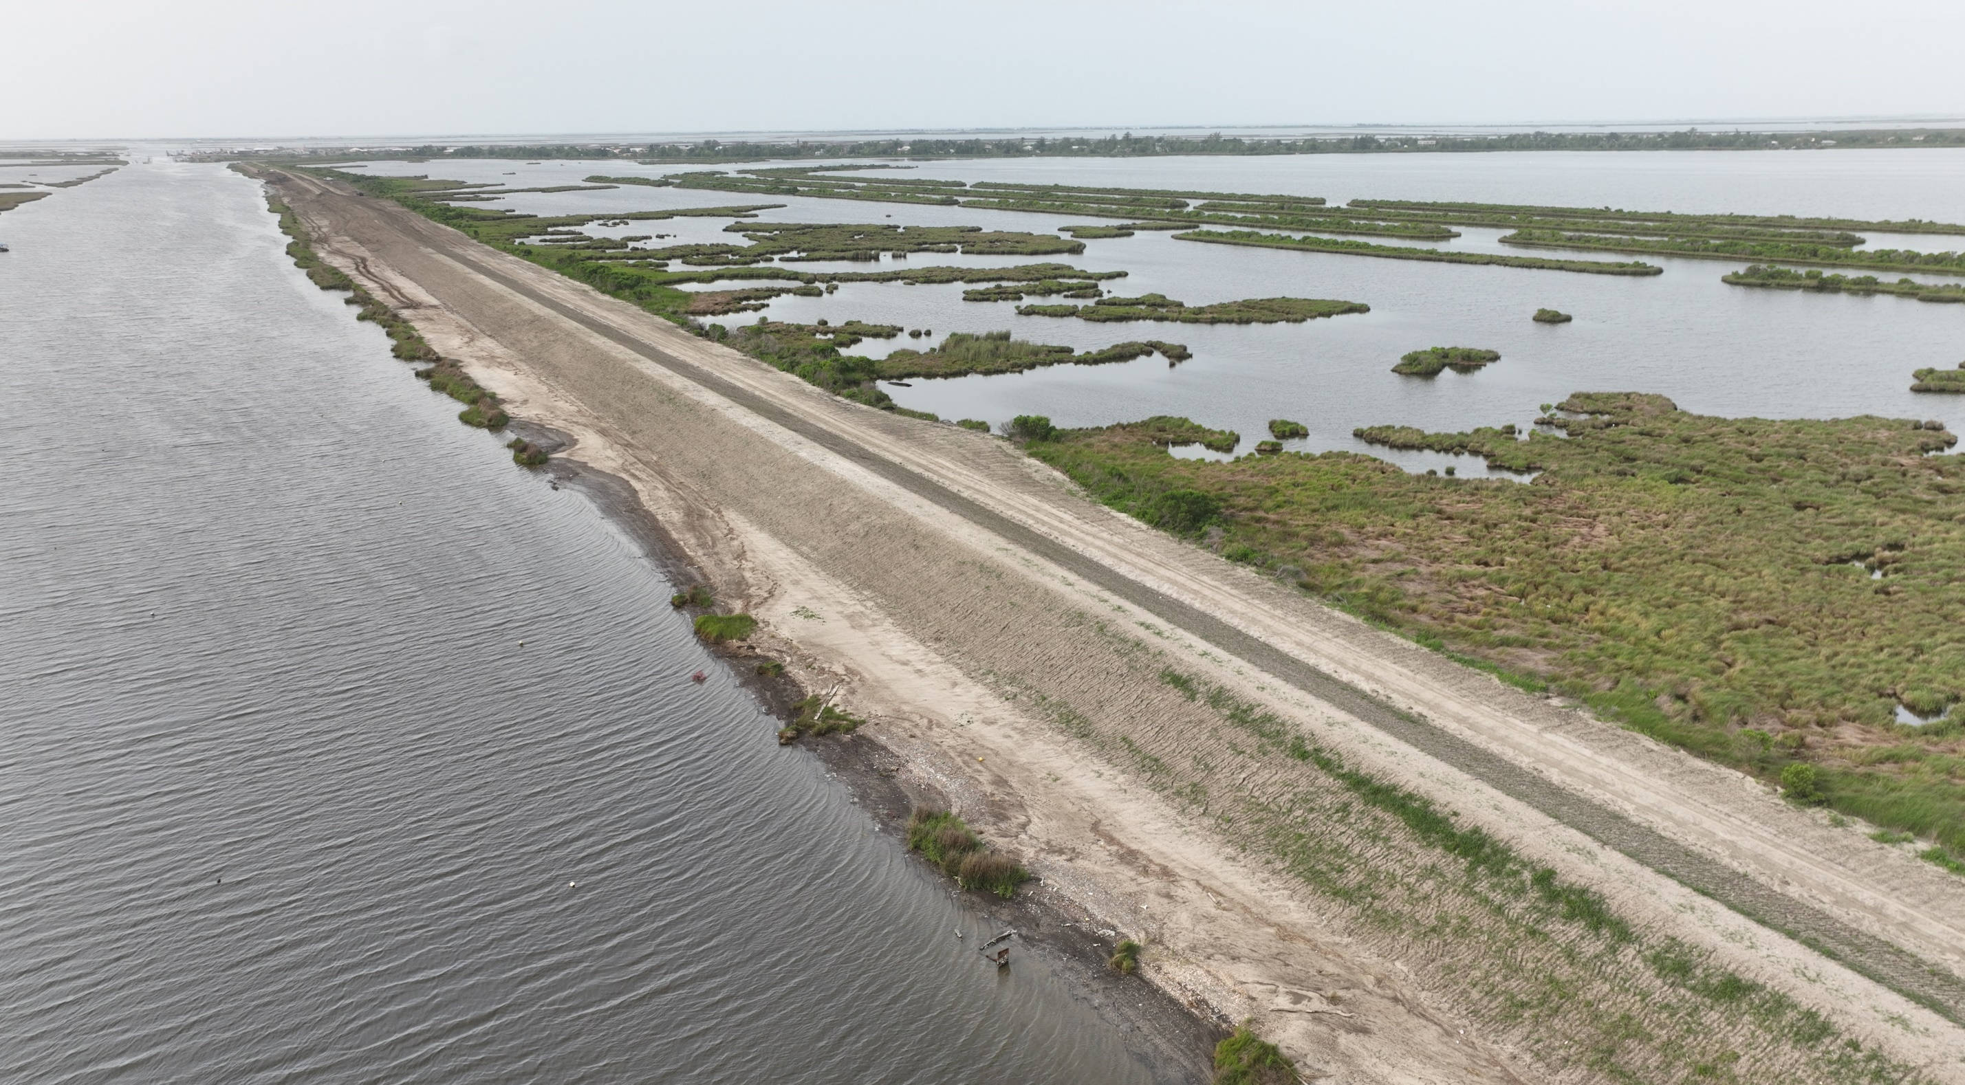
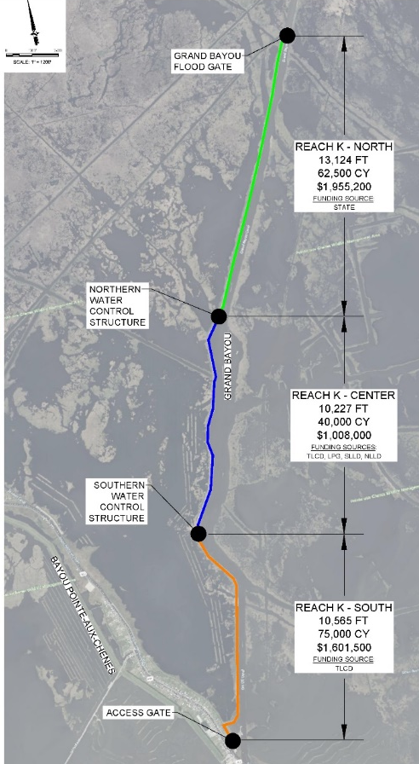
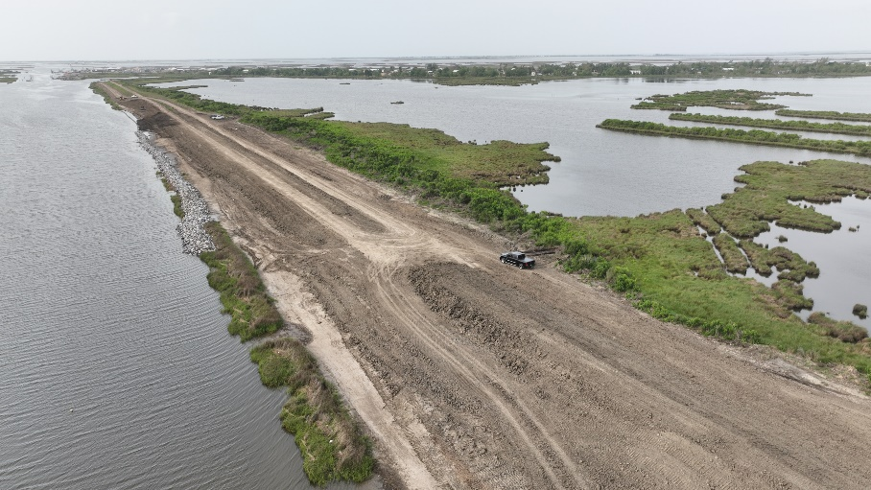
REACH K LEVEE IMPROVEMENTS (+11) – IN CONSTRUCTION
Engineer: All South Consulting Engineers, LLC Contractor: Onshore Materials, LLC & Low Land Construction Co., Inc
Total Cost: $4.6 Million
Funded By: TLCD, TPCG, SLLD, NLLD, LPG, CPRA
Total Fill: 200k Cubic Yards
Completion: Late 2024

Slide 26
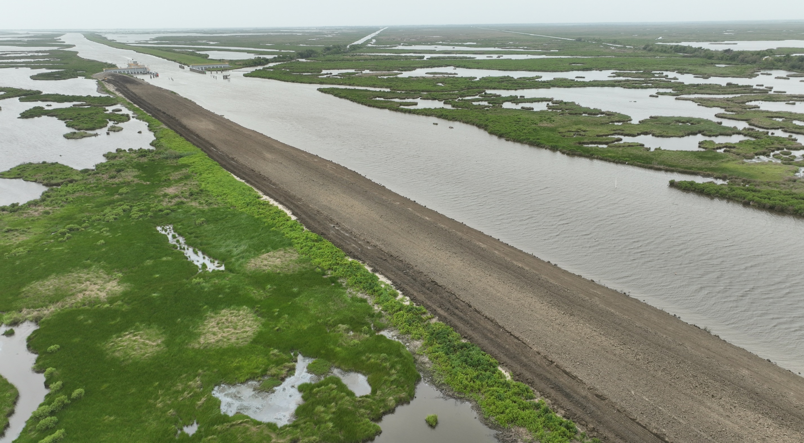
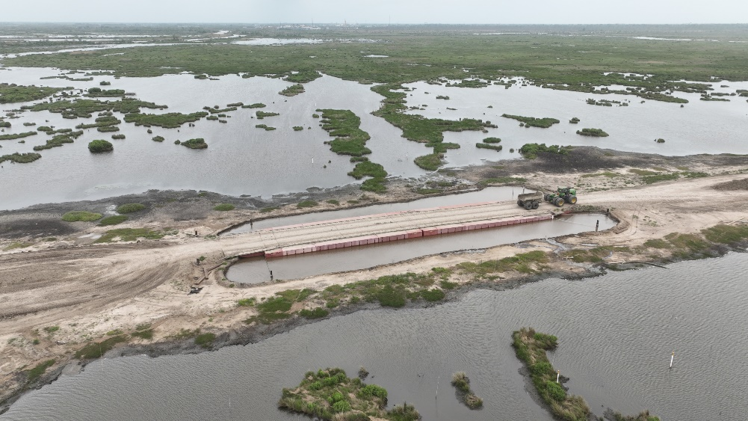
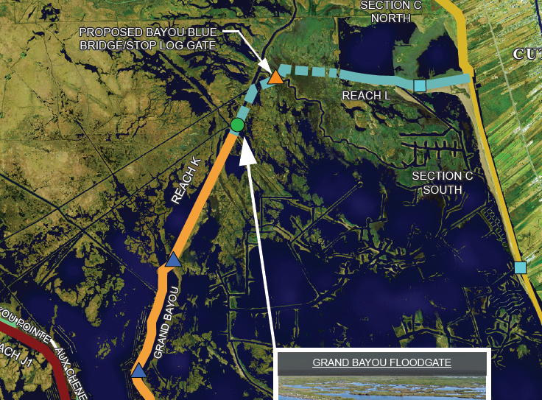
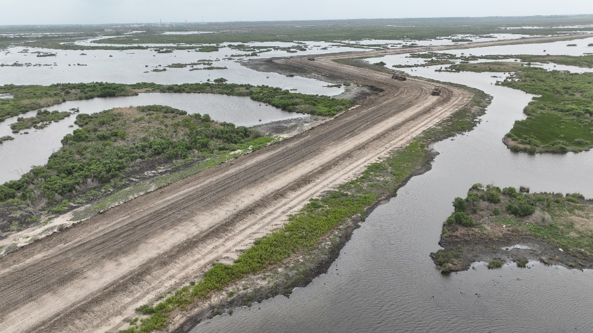
REACH L LEVEE & IMPROVEMENTS (+12) – IN CONSTRUCTION
Engineer: Angelette Design, LLC
Contractor: Onshore Materials, LLC
Total Cost: $20.2 Million
Funded By: CPRA
Total Fill: 600k Cubic Yards
Completion: Late 2024

Slide 27
CURRENT USACE MTG PROJECTS
ICWW SECTOR GATES (EAST & WEST) IN DESIGN
NEW REACH A LEVEE AWARD JULY 2024
REACH F LEVEE IMPROVEMENTS IN DESIGN
NEW BAYOU TERREBONNE SECTOR GATE IN DESIGN
HUMBLE CANAL PRELOAD COMPLETE
NEW HUMBLE CANAL SECTOR GATE IN DESIGN
REACH J-2 LEVEE IMPROVEMENTS IN DESIGN
REACH K LEVEE IMPROVEMENTS IN DESIGN
REACH L LEVEE IMPROVEMENTS IN DESIGN

Slide 28
INVESTMENTS TO DATE
Terrebonne Levee District (TLCD) $300 Million
State of Louisiana (CPRA) $300 Million
HNC Lock Complex (RESTORE Act) $400 Million
Terrebonne Parish Flood Control $200 Million
Total State & Local Investment $1.2 BILLION
Federal Funding Appropriated to Date $468 Million
Federal Funds Expected FY 2025 $93 Million
TOTAL INVESTMENT $1.761 BILLION
Completed and/or under construction along the 98-mile MTG alignment:
• 80 Miles of Levees
• 14 Navigable Floodgates
• 2 Navigable Non-Federal Lock Complexes
• 1 HNC Lock Complex
• 11 Environmental Structures

Slide 29
Prepared By:

